Slide 1
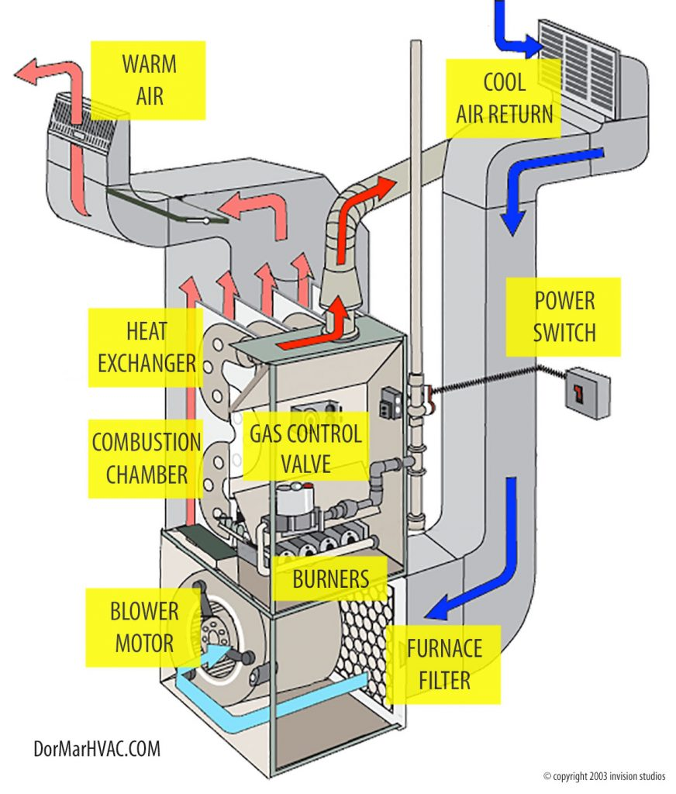
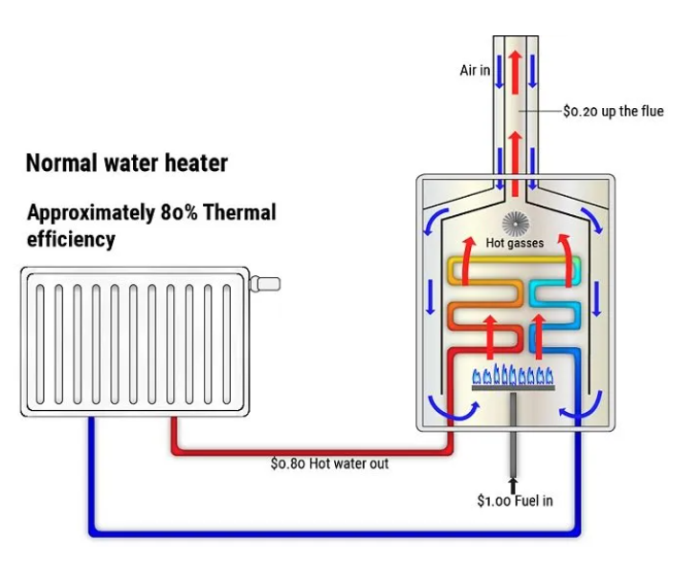
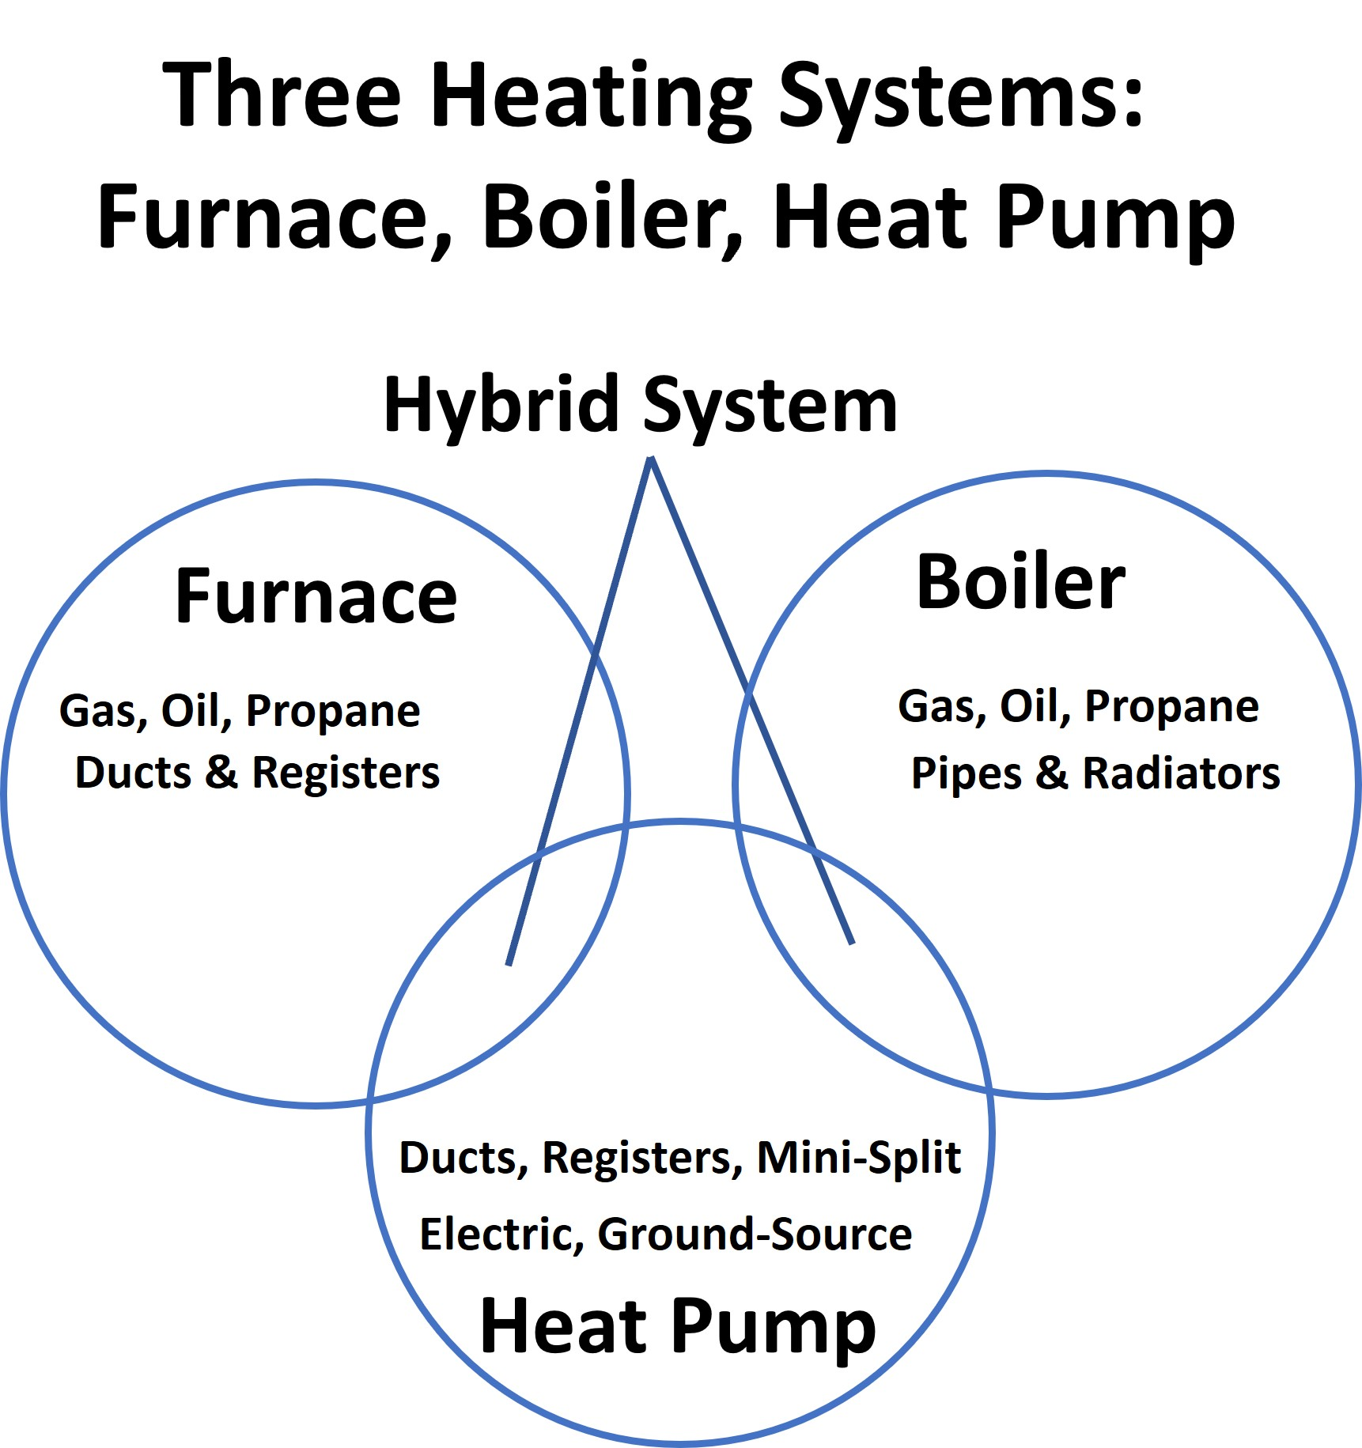
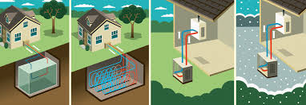
How not to freeze you’re A** off in the dark
350 MKE Presentation, March 14, 2023
Consumer’s Choice
By
Daniel Folkman
Charles Bensinger
350 MKE Presentation March 14, 2023

Slide 2
Suggested Topics for tonight's Zoom Session
What are your options when you decide to stop using gas (a.k.a. natural gas - methane, a potent Green House Gas) to heat your house and your water?
  Or, gas has become too expensive?
  Or, gas is no longer available?
What are the alternatives?
What are the strategies and green technologies for existing and new construction to bring your home to a net-zero carbon footprint.

Slide 3
Suggested Topics for tonight's Zoom Session
I assume that the incentives in the Inflation Reduction Act will be covered and highlighted.
It should be admitted during the meeting, however, that switching to electric heating in a 1920s hot water radiator-heated home like ours is generally not feasible. The better option is to invest in an energy efficient furnace.
Linda
We don’t have the duct work for the heating system to run through. That leaves you with the option of installing a one-room unit. That’s not very practical, although it could operate as heating and air conditioning and could be supplemented with gas heat. The outdoor portion of the installation is also undesirable, especially since we have a deck extending from the back of the house.
This is my understanding of things, coming from someone with very limited mechanical knowledge.

Slide 4
Suggested Topics for tonight's Zoom Session
We have hot water radiant baseboard/floor heat. Two options that I’ve been exploring relate to ground source heat pumps or electric boiler to replace our current (efficient, 8 year old) gas boiler. The IRA has moved up the timeline,
Vertical, vs horizontal, ground pipes mean that not much of your yard is torn up and directional drilling means no trenching. The heat pump compressor can be installed in the basement or utility room.
I’ve also looked at Air-Liquid Mini-splits for air conditioning - they can also be effective heating for cool weather, then supplemented by the radiant heat system when colder temperatures arrive. Installation is more complex than changing the source for your radiant hot water boiler system. The compressor is like a standard outdoor air conditioner.
Gas is currently cheaper than electricity for heating. These solutions are for those of us with means. Hopefully the IRA will enlarge that base!
We love the radiant heating and wouldn’t want to go to forced air.

Slide 5
Spoiler Alert
Spoiler alert1: it is absolutely necessary if our publicly policy advocacy results in zero fossil fuel use by 2050. This will require an all-electric utility for lighting, cooking, heating, air conditioning and transportation. Plus everything else along the way.
Spoiler alert 2: It is absolutely within our reach well before the year 2050 by relying on existing technology. Any new technology coming to scale will only help us achieve this massive transition off fossil fuels sooner rather than later.
Spoiler alert 3. We must start deploying our existing technology at scale to ensure we meet the 2050 deadline. Getting to scale requires a massive effort on all levels from the most personal( our homes and neighborhoods) to the national and global arena. Recall the phrase- think globally, act locally.
Spoiler alert 4: relying on government and private sector action is necessary but not sufficient. Bill McKibben is urging us to implement and deploy at scale. Okay, implement what and at what scaly?
Spoiler alert 5; if it takes a village to raise a child. It will take a community enterprise to energy retrofit our central city low-income housing stock by 2050. We now have 1,400 weeks to get the job done.
Spoiler alert 6: We have no time to waste. A little math.
There are about 116,000 single to four family housing units in Milwaukee’s central city. That’s 83 deep retrofits per week.

Slide 6
Efficiency of Residential Furnaces, Boilers and Heat Pumps
Furnaces:
Annual Fuel Utilization Efficiency (AFUE): Typically ranges from 80% to 98%. Furnace's efficiency over a year.
Boilers:
Annual Fuel Utilization Efficiency (AFUE): Typically ranges from 85% to 98%. Boiler's ability to transfer heat to water in a home's radiators.
Heat pumps:
Heating Seasonal Performance Factor (HSPF): Typically ranges from 7 to 10. This measures the efficiency of an air-source heat pump during the heating season.
Seasonal Energy Efficiency Ratio (SEER): Typically ranges from 14 to 25. This measures the efficiency of an air-source heat pump during the cooling season.
Coefficient of Performance (COP): Typically ranges from 2.5 to 4+. This measures the efficiency of a heat pump over a year. Energy moved compared to Energy Used
The exact efficiency ratings for a specific furnace, boiler, or heat pump depends on several factors, including the brand, model, and size of the system, as well as the climate and usage patterns of the home.

Slide 7

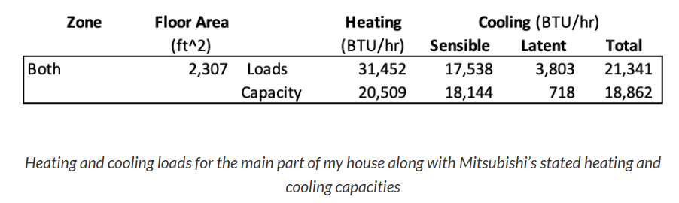
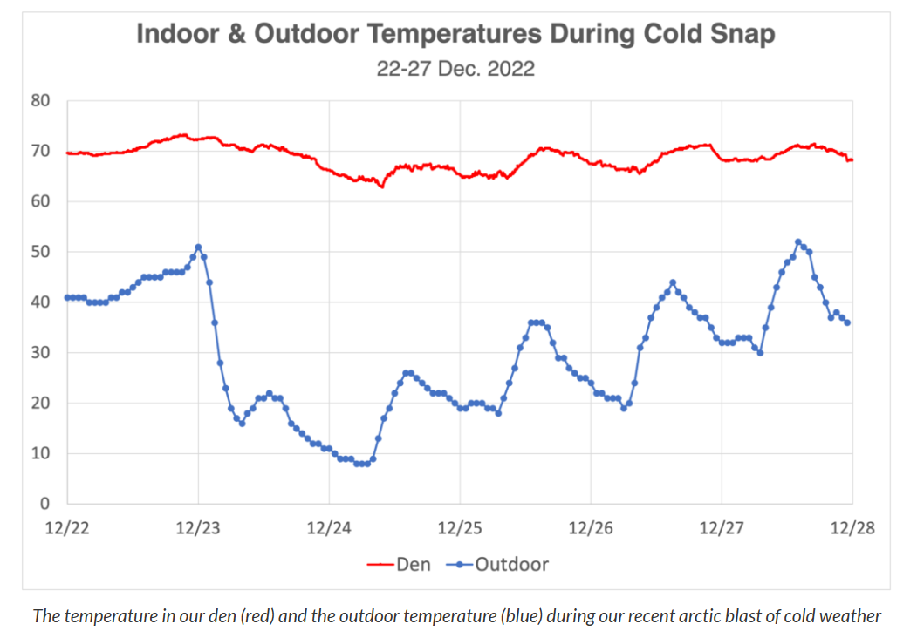
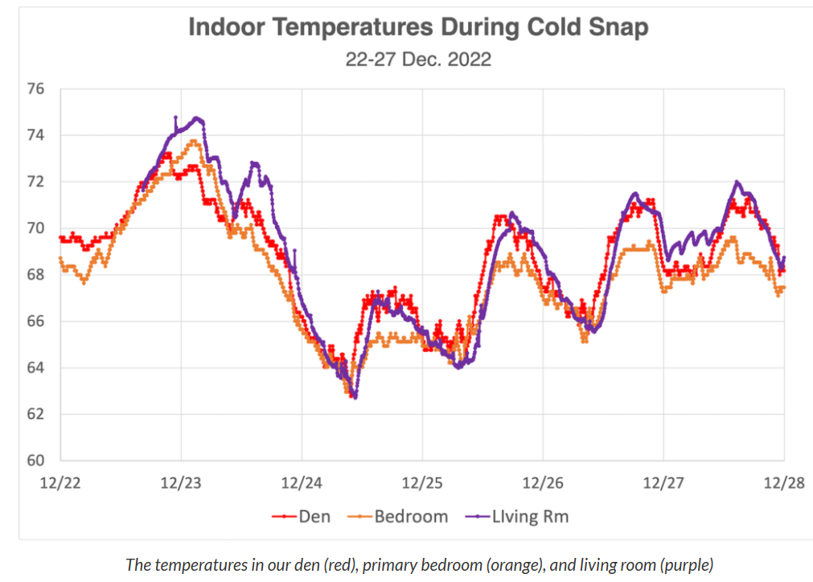
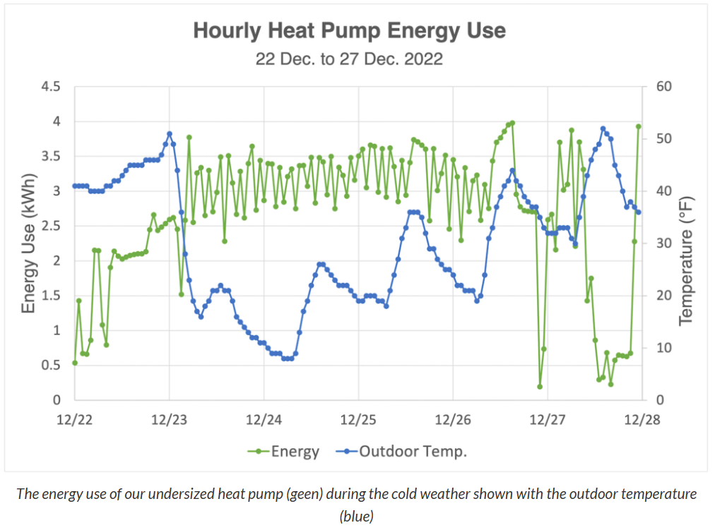
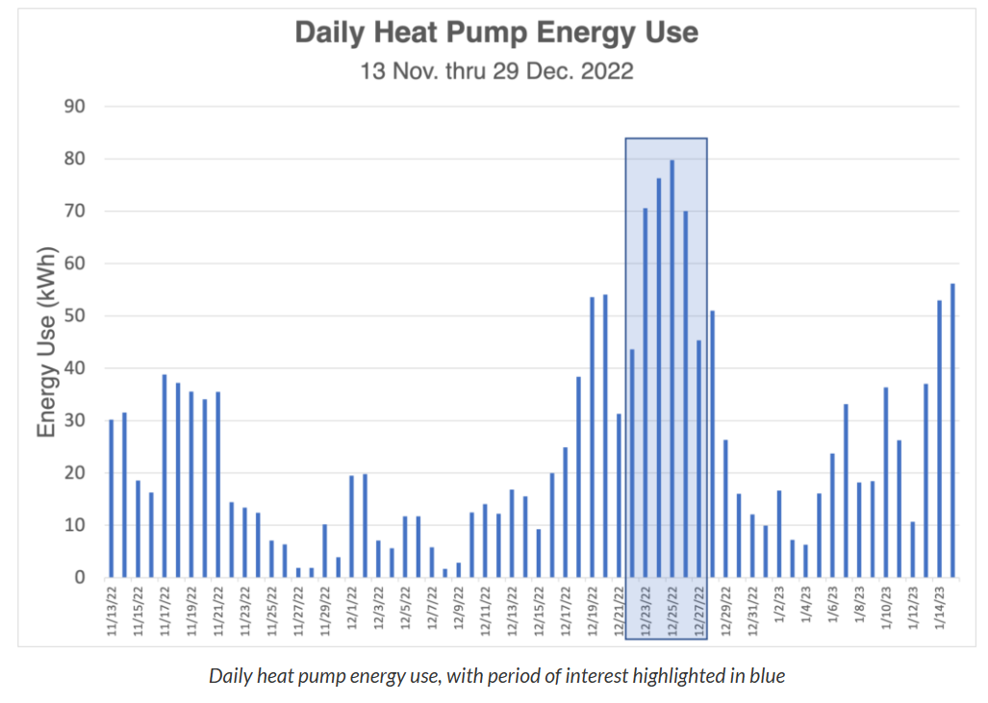
Atlanta Georgia
https://www.energyvanguard.com/
My Undersized Heat Pump in an Arctic Blast - Energy Vanguard
70f
40f
63f
Indoor Temp
Outdoor Temp
House Load
Mote: Heat Pump Undersized
7f
The table above shows the heating and cooling loads (first row) and the capacity of the heat pump (second row). As you can see, this heat pump serves ~2,300 square feet of floor area. Our heating load is 31,452 BTU per hour (9 kW). The heat pump, according to Mitsubishi’s data, can provide only 20,509 BTU per hour of heat (6 kW). The equipment I selected includes one outdoor unit, the Mitsubishi MXZ-3C24NAHZ2 with Hyper-Heat, and two horizontal ducted indoor units.

Slide 8
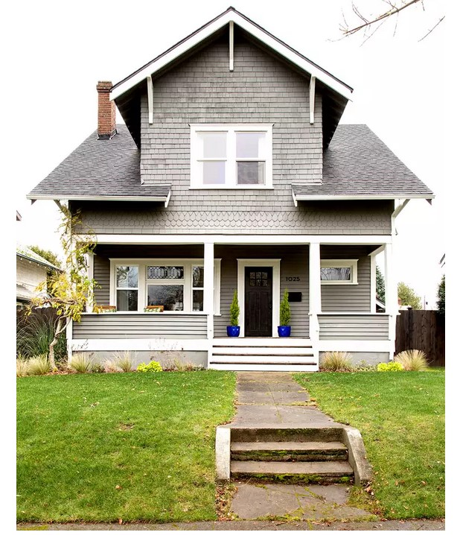
Deep Retrofit Options for Older Homes in Milwaukee
Prepared for MKE 350.org by:
Dan Folkman and
Charlie Bensinger
March 14, 2023

Slide 9
This presentation explores the potential for reduction in energy use that may result from various energy efficiency strategies and the community education necessary to ensure success.
1. Deep Energy Retrofits
2. Pros and Cons of Heat Pumps
3. Need for Community Education
A key factor in achieving the desired energy use reduction and potential financial savings is identifying the specific needs of a building when selecting a retrofit strategy.

Slide 10
Key Energy Saving Steps
Conduct an energy audit.
Seal air leaks and add insulation.
Upgrade heating, ventilation, and air conditioning (HVAC) systems to more efficient models.
Install energy-efficient lighting, appliances, and electronics.
Consider adding solar panels or geothermal heating to offset utility energy usage.
Adopt energy-saving behaviors such as turning off lights and electronics when not in use,
Monitor energy usage and track savings.

Slide 11
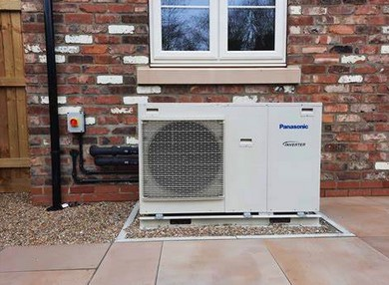
The Deep Energy Retrofit
Upgrade or replace all heating, cooking, and electrical appliances and eliminate energy leaks in the home by undertaking a variety of state-of-the-art insulating strategies.
Replace the old gas furnace or boiler with a new, high-efficiency model with an Annual Fuel Utilization Efficiency (AFUE) rating of 90% or higher, which means that they convert 90% or more of the fuel they use into heat. These units can provide significant energy savings compared to older, less efficient models.
Replace the gas furnace with a heat pump.

Slide 12
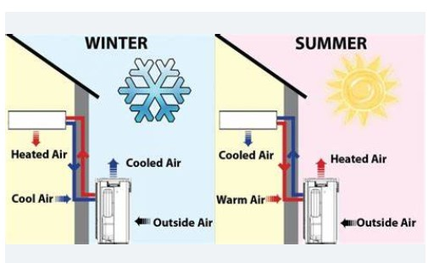
Heat Pumps
Heat pumps are efficient heating and cooling systems that use electricity to move heat from one location to another. In the winter, heat pumps extract heat from the outdoor air and use it to warm the indoor air. In the summer, they reverse the process to cool the indoor air. Adding a heat pump to a gas furnace or boiler can provide additional heating efficiency and can also provide cooling during the summer months.

Slide 13
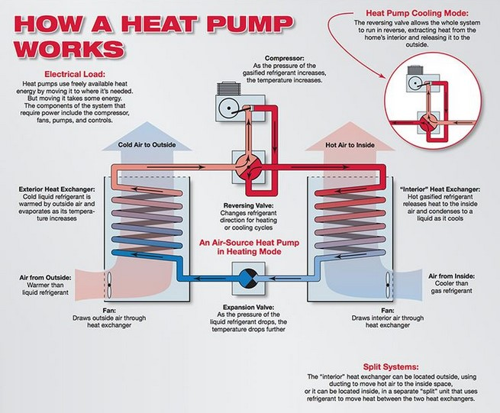

Slide 14

Heat Pump Options

Slide 15
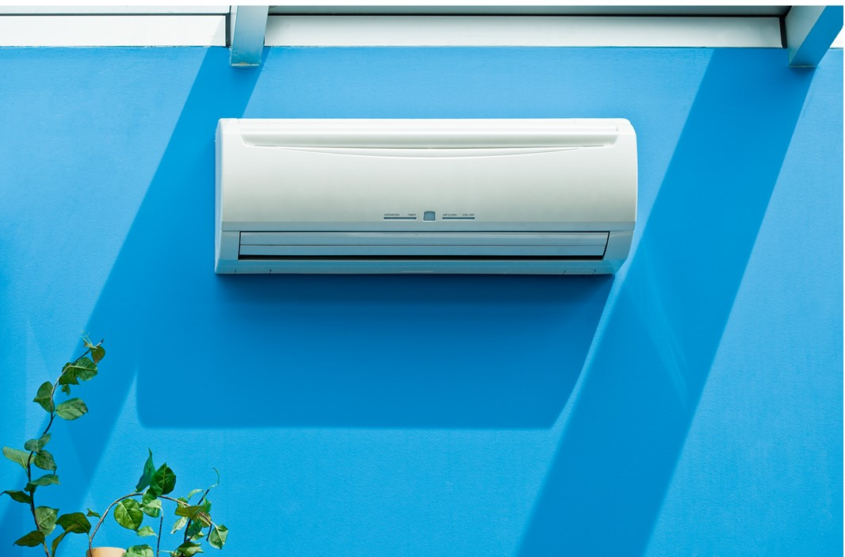
Mitsubishi Electric Heat Pump:
Provides 100% of heating requirement at 5º F
Will operate to -13º F without auxiliary heat
Electric-H2i plus technology can deliver up to 100% heating capacity to -5º F

Slide 16
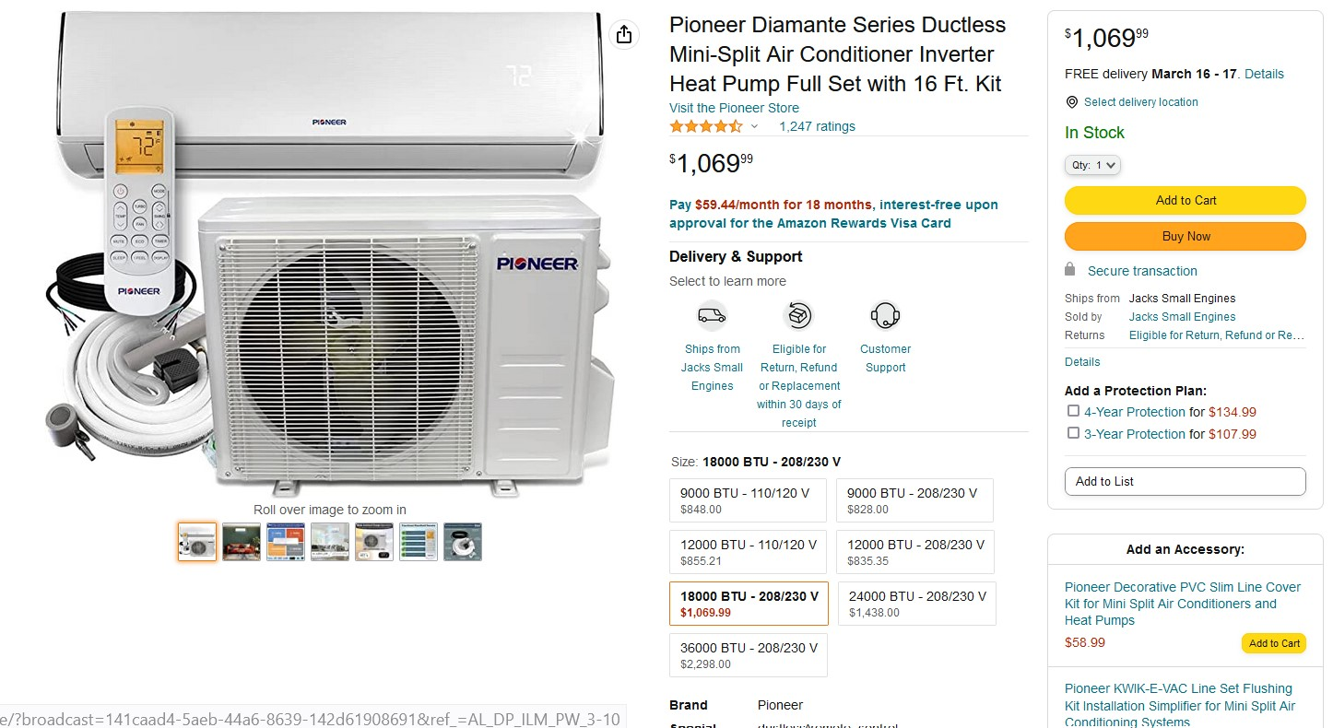

Slide 17
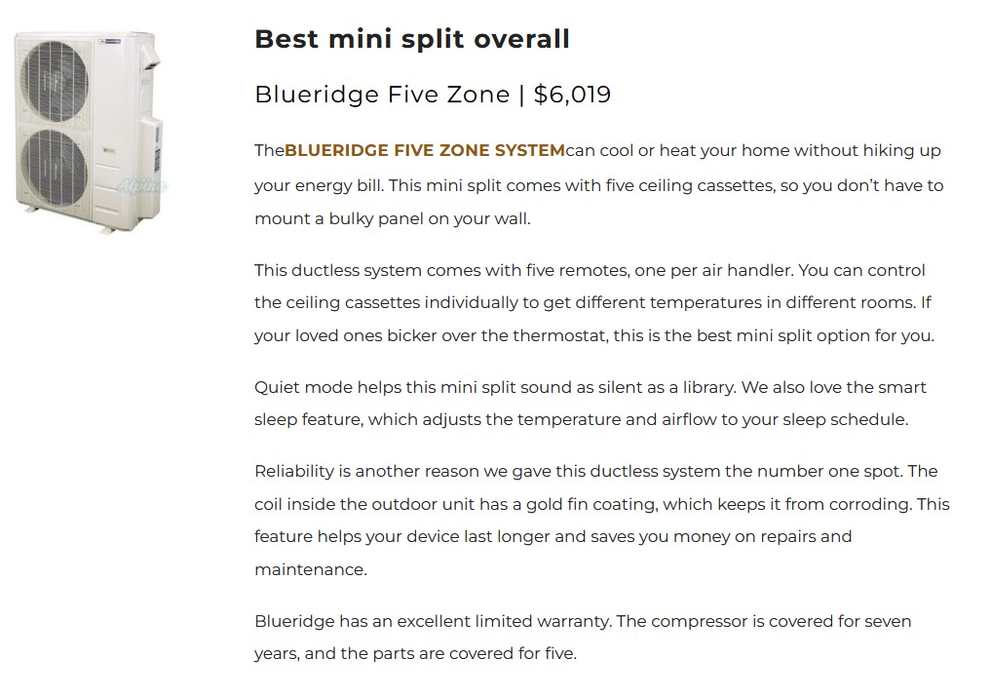

Slide 18


Slide 19
Pros of Heat Pumps:
Decarbonation (200% to 300% greater efficiency than gas furnace)
Asthma reduction – filters air, producing better air quality
Less humidity – removes moisture from air
Lower energy bills (could save $400-$500/yr in heating bills
Saves space -- provides both air conditioning and heat
Less noise – quieter than an air conditioner
Improved safety – no gas leaks
Cons of Heat Pumps:
More mechanically complex
All units and parts not manufactured in the U.S.
Requires more maintenance
More expensive than conventional HVAC systems ($5,000- $12,000)
Technicians not experienced in installation and repair yet

Slide 20
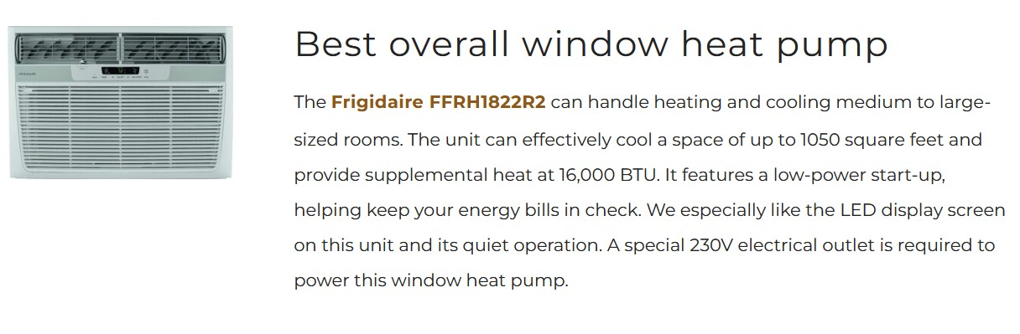
A Possible solution for renters:
window-mounted heat pumps
Price: @ $600 at Home Depot.

Slide 21
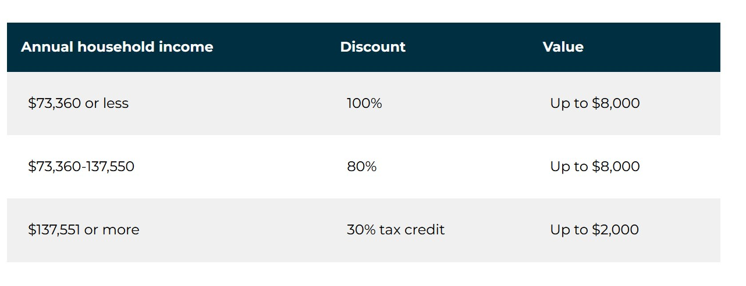
Financial assistance from the Inflation Recovery Act to help pay for energy efficiency upgrades

Slide 22
Factors to Consider in Upgrading your Heating and AC System
Age and condition of the existing system.
The cost and complexity of retrofitting the existing system to work with a heat pump. It may be more practical to replace the entire system with a new heat pump.
Ultimately, the best option will depend on the specific needs and circumstances of the homeowner. Consulting with a qualified HVAC professional can help homeowners determine the most effective and efficient heating solution for their home.

Slide 23
Key factors to keep in mind when getting bids for upgrades:
Do your research. Understand the pros and cons of each type of system and what might work best for your home and climate.
Choose a qualified contractor, well-versed in the latest technology.
Get multiple bids for several contractors. Don’t just go with the least expensive.
Look for rebates and incentives.
Consider the whole system: heating and cooling, ductwork and insulation.
Think about long-term savings or lifetime cost, not just the initial capital cost.
Consider adding or switching to a heat pump.

Slide 24
System Comparison Chart
System Type | Description | Efficiency Range | Pros | Cons
Furnaces | Furnaces use natural gas, propane, or oil to heat air that is then distributed throughout the home via ducts. | 80% to 98% AFUE | - Quick and efficient heating - Can be paired with an air conditioner for central heating and cooling - Lower upfront costs than some other systems | - Relies on fossil fuels - Ductwork can be leaky and reduce efficiency
Boilers | Boilers heat water that is then circulated through radiators or underfloor pipes to provide heat. | 80% to 98% AFUE | - Even heating - No ductwork required - Can be used to heat water for domestic use | - Higher upfront costs than some other systems - Can take longer to heat up than furnaces
Heat Pumps | Heat pumps use electricity to move heat from one location to another, providing both heating and cooling. | 8.2 HSPF to 13 HSPF | - Highly efficient in moderate climates - Can provide both heating and cooling - Can reduce energy bills when used in place of a furnace and air conditioner | - May not be as effective in extreme climates - Can have higher upfront costs than some other systems
Note: AFUE stands for Annual Fuel Utilization Efficiency and HSPF stands for Heating Seasonal Performance Factor. These are measures of how efficiently the system converts fuel or electricity into heat.

Slide 25
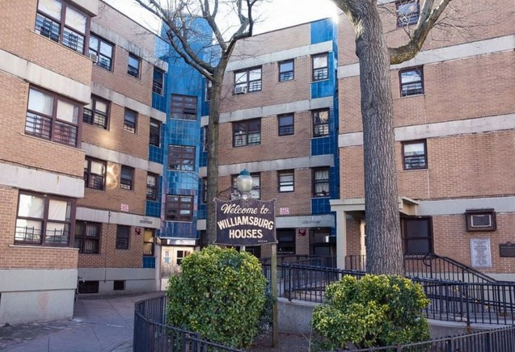
What New York City is doing to address the “energy burden” suffered by low-income residents in rental housing:
$70 million for 30,000 heat pumps for public housing
60 units will be installed in winter to test energy efficiency and practicality
Clean Heat For All Challenge will provide funding for the development of made-in-the-USA heat pumps to be delivered to NYC Housing Agencies

Slide 26
The Importance of Community Education
Because of the complexity of identifying a cost-effective and successfully retrofit strategy, it is imperative that homeowners receive access to the appropriate expertise that can enable them to make sensible and successful decisions. Factors to consider include:
Emphasize the importance of energy efficiency
Explain the basics of HVAC systems -- including furnaces, boilers, heat pumps, AC units.
Provide guidance on choosing the right contractor.
Discuss financing: tax credits, grants, loans, green mortgages, rebates, etc.
Highlight the benefits of regular maintenance and system use efficiency.
An important component in the public education process is the Community Benefit Organization or CBO. The CBO can choose to provide a one-on-one assistance and may offer the following types of support: Evaluation, Guidance on Financing, Referrals and Negotiating Contracts.

Slide 27
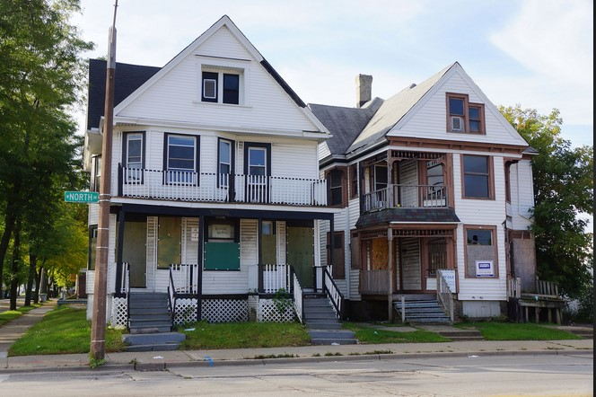
Existing Community Organizations Working to Reduce the Energy Burden of MKE’s low-income residents
Revitalize Milwaukee (has $12M in new funding for EE upgrades)
Bronzeville Tech Hub
Walnut Way
Habitat for Humanity
Washington Park Media Center
HomeWorks: Bronzeville LLC

Slide 28
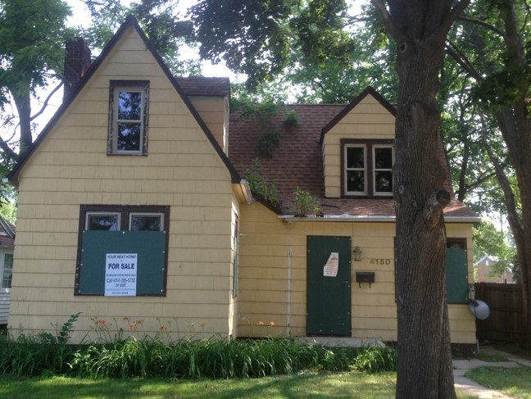
Is there a role here for MKE 350?
If so, define.

Slide 29
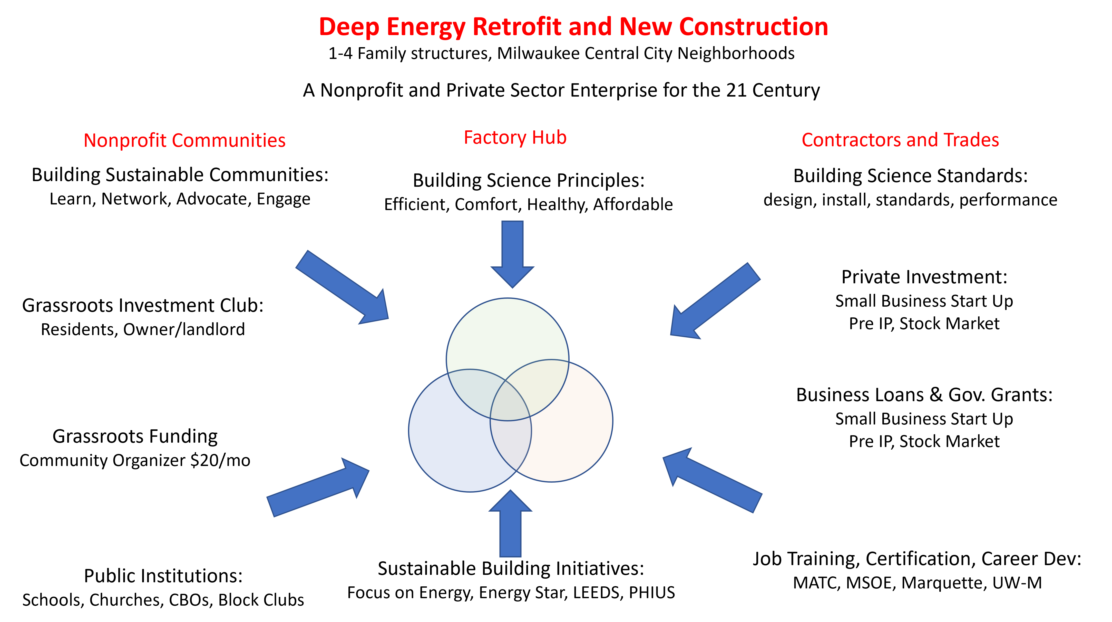
Plan
Implement
Monitor

